Slide 1
CODEBASICS RESUME CHALLENGE - SEPTEMBER
Presented By
-Shubham Shaah

Slide 2
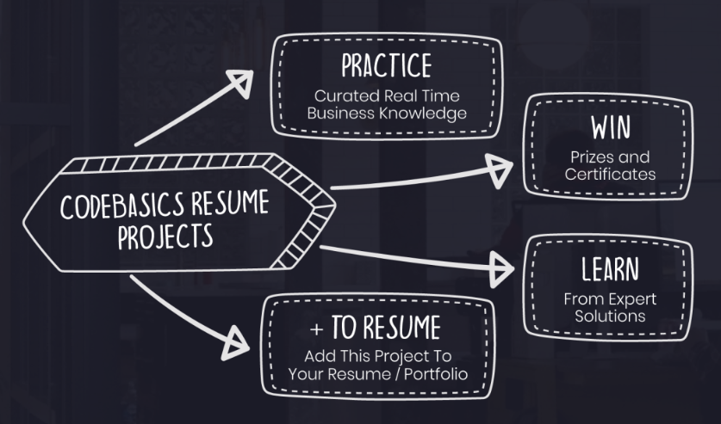
Format of the challenge

Slide 3
Dataset Details
We are provided 3 moths booking details data of all the Atliq hotels.
Dataset contains 5 .csv files.
Dim_date
Dim_hotels
Dim_rooms
Fact_aggregated_bookings
Fact_bookings
Metric list excel file
Mock-up Dashboard

Slide 4
Analysis Task
We have been provided with the data of Atliq Grands’ hotels in India
Our job is to give insights to the revenue team in the form of Dashboard using the given data
Using these insights the team at Atliq Grands would be able to take decisions to regain their market share and revenue

Slide 5
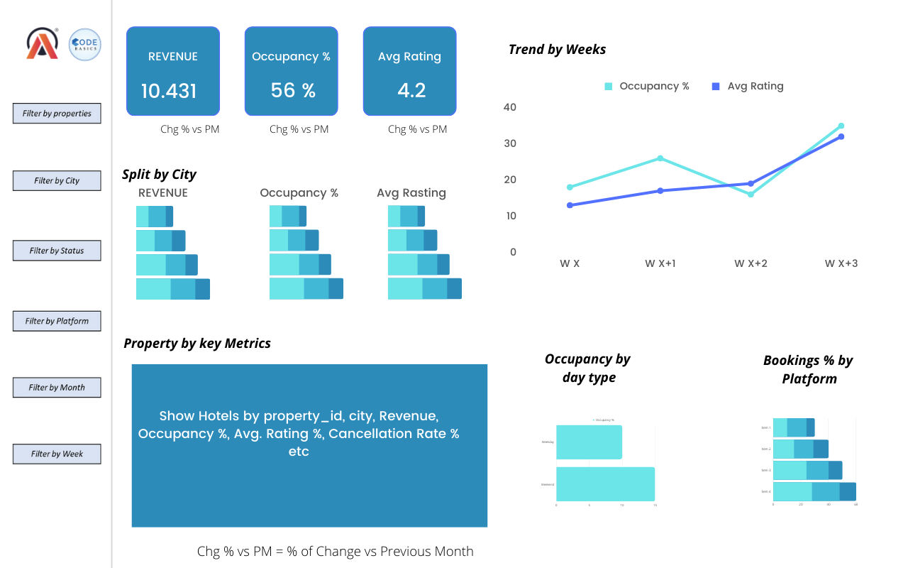
Mock-up Dashboard

Slide 6
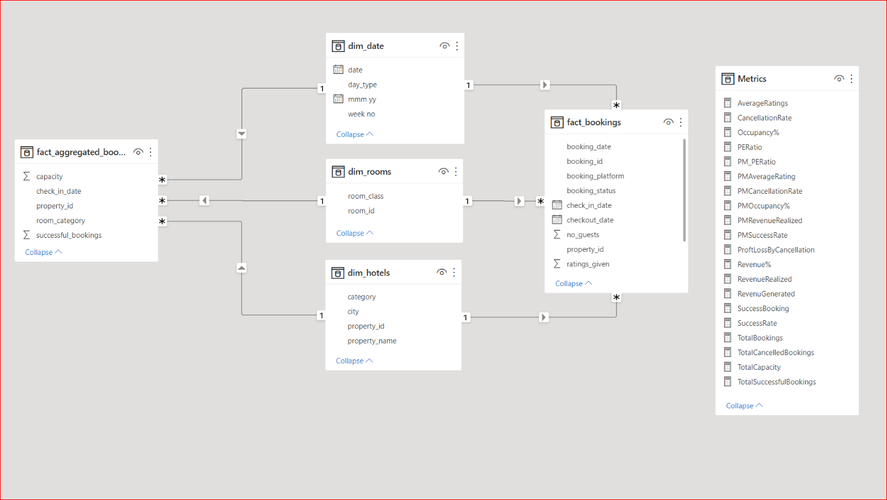
Data Model

Slide 7
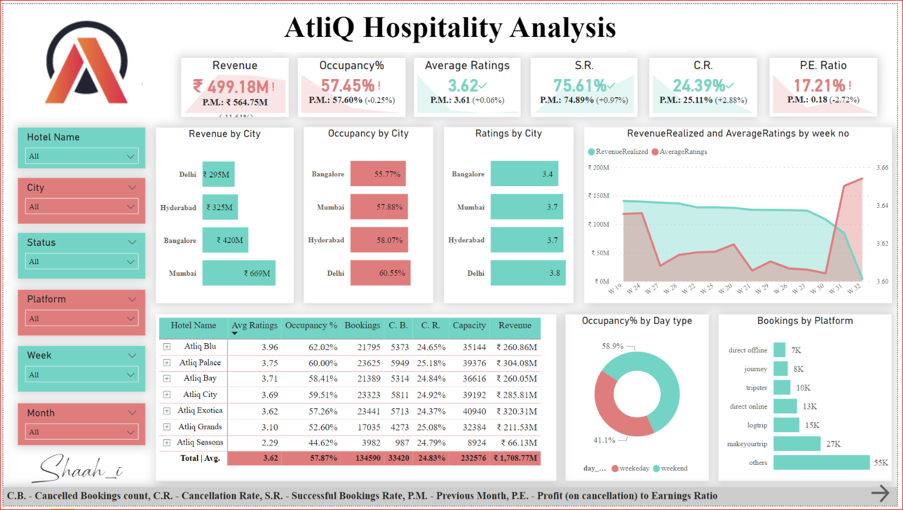
Dashboard

